Slide 1
Learning Gaussian Bayes Classifiers
Note to other teachers and users of these slides. Andrew would be delighted if you found this source material useful in giving you r own lectures. Feel free to use these slides verbatim, or to modify them to fit your own needs. PowerPoint originals are available. If you make use of a significant portion of these slides in your own lecture, please include this message, or the following link to the source repository of Andrew’s tutorials: http://www.cs.cmu.edu/~awm/tutorials . Comments and corrections gratefully received.
Andrew W. Moore Associate Professor
School of Computer Science Carnegie Mellon University
www.cs.cmu.edu/~awm awm@cs.cmu.edu
412-268-7599
Copyright © 2001, Andrew W. Moore
Sep 10th, 2001
Maximum Likelihood learning of Gaussians for Classification
Why we should care
3 seconds to teach you a new learning algorithm
What if there are 10,000 dimensions?
What if there are categorical inputs?
Examples “out the wazoo”
Copyright © 2001, Andrew W. Moore
Gaussian Bayes Classifiers: Slide 2

Slide 2
Why we should care
One of the original “Data Mining” algorithms
Very simple and effective
Demonstrates the usefulness of our earlier groundwork
Copyright © 2001, Andrew W. Moore
Gaussian Bayes Classifiers: Slide 3
Where we were at the end of the MLE lecture…
Categorical inputs only
Real-valued inputs only
Mixed Real / Cat okay
Inputs Inputs Inputs
Classifier
Predict
Joint BC Naïve BC
Dec Tree
category
Joint DE Naïve DE
Gauss DE
 | Density Estimator
Prob- ability
Regressor
Predict real no.
Copyright © 2001, Andrew W. Moore
Gaussian Bayes Classifiers: Slide 4

Slide 3

This lecture…
Categorical inputs only
Real-valued inputs only
Mixed Real / Cat okay
Inputs Inputs Inputs
Classifier
Predict category
Joint BC
Naïve BC
Gauss BC
Dec Tree
 | Density Estimator
Prob- ability
Joint DE Naïve DE
Gauss DE
Regressor
Predict real no.
Copyright © 2001, Andrew W. Moore
Gaussian Bayes Classifiers: Slide 5
Road Map
Probability
Density Estimation
Decision Trees
PDFs
MLE
Gaussians
Bayes Classifiers
MLE of Gaussians
Copyright © 2001, Andrew W. Moore
Gaussian Bayes Classifiers: Slide 6

Slide 4

Road Map
Probability
Decision Trees
PDFs
Density Estimation
MLE
Gaussians
Bayes Classifiers
MLE of Gaussians
Gaussian Bayes Classifiers
Copyright © 2001, Andrew W. Moore
Gaussian Bayes Classifiers: Slide 7
Gaussian Bayes Classifier Assumption
The i’th record in the database is created using the following algorithm
Generate the output (the “class”) by drawing y_{i}~Multinomial(p₁,p₂,…p_{Ny})
Generate the inputs from a Gaussian PDF that depends on the value of y_{i} :
x_{i} ~ N(μ_{i} ,Σ_{i}).
Test your understanding. Given N_{y} classes and m input attributes, how many distinct scalar parameters need to be estimated?
Copyright © 2001, Andrew W. Moore
Gaussian Bayes Classifiers: Slide 8

Slide 5
MLE Gaussian Bayes Classifier
Let DB_{i} = Subset of database DB in which the output class is y = i
|DB |
the database is created
• The i’th record in using the followin
i
= ------
m
Generate the output (the “class”) by drawing y_{i}~Multinomial(p₁,p₂,…p_{Ny})
Generate the inputs from a Gaussian PDF that depends on the value of y_{i} :
x_{i} ~ N(μ_{i} ,Σ_{i}).
Test your understanding. Given N_{y} classes and m input attributes, how many distinct scalar parameters need to be estimated?
Copyright © 2001, Andrew W. Moore
p
_{i}mle
g algorith_{|DB|}
Gaussian Bayes Classifiers: Slide 9
MLE Gaussian Bayes Classifier
Let DB_{i} = Subset of
• The i’th record in using the followin
the database is created
database DB in which
the output class is y = i ^{g algorithm}
1. Generate the output (the “class”) by
(μ _{i}^{mle}, Σ ^{mle} )= MLE Gaussian for DB_{i}
draw^{i} ing y_{i}~Multinomial(p₁,p₂,…p_{Ny})
2. Generate the inputs from a Gaussian PDF that depends on the value of y_{i} :
x_{i} ~ N(μ_{i} ,Σ_{i}).
Test your understanding. Given N_{y} classes and m input attributes, how many distinct scalar parameters need to be estimated?
Copyright © 2001, Andrew W. Moore
Gaussian Bayes Classifiers: Slide 10

Slide 6
MLE Gaussian Bayes Classifier
Let DB_{i} = Subset of database DB in which the output class is y = i
the database is created g algorithm
• The i’th record in using the followin
1. Generate the output (the “class”) by
(μ _{i}^{mle}, Σ ^{mle} )= MLE Gaussian for DB_{i}
draw^{i} ing y_{i}~Multinomial(p₁,p₂,…p_{Ny})
2. Generate the inputs from a Gaussian PDF that depends on the value of y_{i} :
x_{i} ~ N(μ_{i} ,Σ_{i}).
mle
1
R
1
R
(x − µ )(x − µ )
^{∑ x k} ndi
mle
∑ k i k i
^{µi =} | DB |
S =
mle
mle ^{T}
Test your understa
ma
ng. Given N_{y} classes and m input attributes, how istinct scalar parameters need to be estimated?
i
x _{k} ∈DB _{i}
ny d
i
| DB |
i x _{k} ∈DB_{i}
Copyright © 2001, Andrew W. Moore
Gaussian Bayes Classifiers: Slide 11
Gaussian Bayes Classification
_{P ( y = i | x) =} p(x | y = i)P ( y = i)
p(x)
Copyright © 2001, Andrew W. Moore
Gaussian Bayes Classifiers: Slide 12

Slide 7
Gaussian Bayes Classification
_{P ( y = i | x) =} p(x | y = i)P ( y = i)
p(x)
¹ exp ⎡− ¹ (x − µ ) S (x − µ )⎤ p
T
P ( y = i | x) =
(2ν )^{m / 2} || S ||^{1 / 2}
⎢⎣
2
p(x )
k
i i k i ⎥⎦ i
i
How do we deal with that?
Copyright © 2001, Andrew W. Moore
Gaussian Bayes Classifiers: Slide 13
Here is a dataset
age | employme | education | edun | marital | … | job | relation | race | gender | hour | country | wealth
 |  |  |  |  | …
39 | State_gov | Bachelors | 13 | Never_mar | … | Adm_cleric | Not_in_fa | White | Male | 40 | United_St | poor
51 | Self_emp_ | Bachelors | 13 | Married | … | Exec_man | Husband | White | Male | 13 | United_St | poor
39 | Private | HS_grad | 9 | Divorced | … | Handlers_c | Not_in_fa | White | Male | 40 | United_St | poor
54 | Private | 11th | 7 | Married | … | Handlers_c | Husband | Black | Male | 40 | United_St | poor
28 | Private | Bachelors | 13 | Married | … | Prof_speci | Wife | Black | Female | 40 | Cuba | poor
38 | Private | Masters | 14 | Married | … | Exec_man | Wife | White | Female | 40 | United_St | poor
50 | Private | 9th | 5 | Married_sp | … | Other_serv | Not_in_fa | Black | Female | 16 | Jamaica | poor
52 | Self_emp_ | HS_grad | 9 | Married | … | Exec_man | Husband | White | Male | 45 | United_St | rich
31 | Private | Masters | 14 | Never_mar | … | Prof_speci | Not_in_fa | White | Female | 50 | United_St | rich
42 | Private | Bachelors | 13 | Married | … | Exec_man | Husband | White | Male | 40 | United_St | rich
37 | Private | Some_coll | 10 | Married | … | Exec_man | Husband | Black | Male | 80 | United_St | rich
30 | State_gov | Bachelors | 13 | Married | … | Prof_speci | Husband | Asian | Male | 40 | India | rich
24 | Private | Bachelors | 13 | Never_mar | … | Adm_cleric | Own_child | White | Female | 30 | United_St | poor
33 | Private | Assoc_ac | 12 | Never_mar | … | Sales | Not_in_fa | Black | Male | 50 | United_St | poor
41 | Private | Assoc_voc | 11 | Married | … | Craft_repai | Husband | Asian | Male | 40 | *MissingV | rich
34 | Private | 7th_8th | 4 | Married | … | Transport_ | Husband | Amer_Indi | Male | 45 | Mexico | poor
26 | Self_emp_ | HS_grad | 9 | Never_mar | … | Farming_fi | Own_child | White | Male | 35 | United_St | poor
33 | Private | HS_grad | 9 | Never_mar | … | Machine_o | Unmarried | White | Male | 40 | United_St | poor
38 | Private | 11th | 7 | Married | … | Sales | Husband | White | Male | 50 | United_St | poor
44 | Self_emp_ | Masters | 14 | Divorced | … | Exec_man | Unmarried | White | Female | 45 | United_St | rich
41 | Private | Doctorate | 16 | Married | … | Prof_speci | Husband | White | Male | 60 | United_St | rich
: | : | : | : | : | : | : | : | : | : | : | : | :
48,000 records, 16 attributes [Kohavi 1995]
Copyright © 2001, Andrew W. Moore
Gaussian Bayes Classifiers: Slide 14

Slide 8
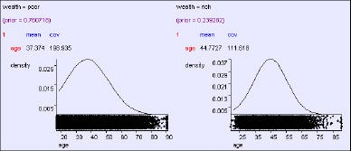
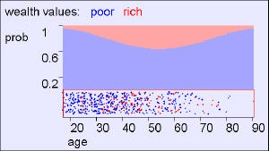
Predicting wealth from age
Copyright © 2001, Andrew W. Moore
Gaussian Bayes Classifiers: Slide 15
Predicting wealth from age
Copyright © 2001, Andrew W. Moore
Gaussian Bayes Classifiers: Slide 16

Slide 9
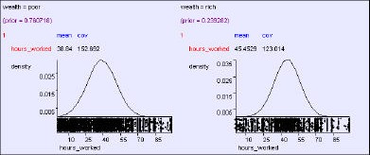
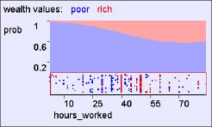
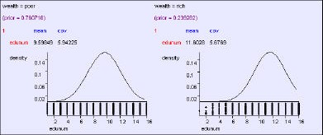
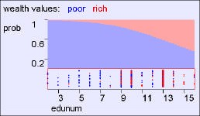
Wealth from hours worked
Copyright © 2001, Andrew W. Moore
Gaussian Bayes Classifiers: Slide 17
Wealth from years of education
Copyright © 2001, Andrew W. Moore
Gaussian Bayes Classifiers: Slide 18

Slide 10
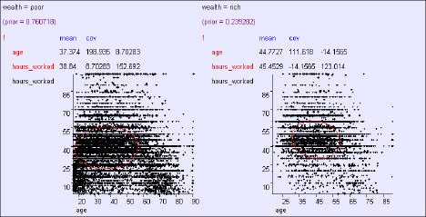
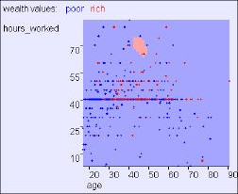
age, hours → wealth
Copyright © 2001, Andrew W. Moore
Gaussian Bayes Classifiers: Slide 19
age, hours → wealth
Copyright © 2001, Andrew W. Moore
Gaussian Bayes Classifiers: Slide 20

Slide 11
age, hours → wealth
Having 2 inputs instead of one helps in two ways:
Copyright © 2001, Andrew W. Moore
Gaussian Bayes Classifiers: Slide 21
age, hours → wealth
Having 2 inputs instead of one helps in two ways:
Combining evidence from two 1d Gaussians
Off- diagonal covariance distinguishes class “shape”
Gaussian Bayes Classifiers: Slide 22
Copyright © 2001, Andrew W. Moore

Slide 12
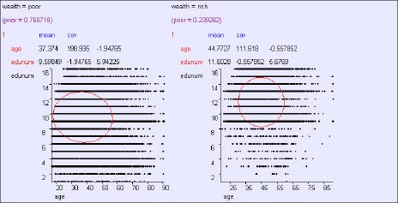
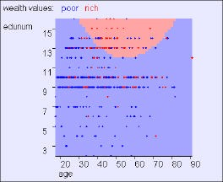
age, edunum → wealth
Copyright © 2001, Andrew W. Moore
Gaussian Bayes Classifiers: Slide 23
age, edunum → wealth
Copyright © 2001, Andrew W. Moore
Gaussian Bayes Classifiers: Slide 24

Slide 13
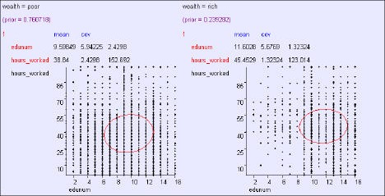
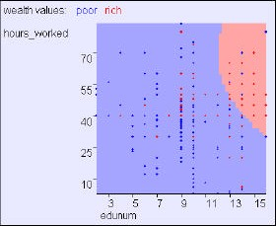
hours, edunum → wealth
Copyright © 2001, Andrew W. Moore
Gaussian Bayes Classifiers: Slide 25
hours, edunum → wealth
Copyright © 2001, Andrew W. Moore
Gaussian Bayes Classifiers: Slide 26

Slide 14





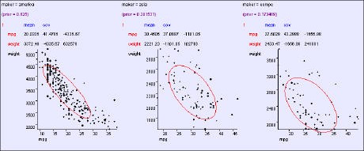
Accuracy
Copyright © 2001, Andrew W. Moore
Gaussian Bayes Classifiers: Slide 27
An “MPG” example
Copyright © 2001, Andrew W. Moore
Gaussian Bayes Classifiers: Slide 28

Slide 15
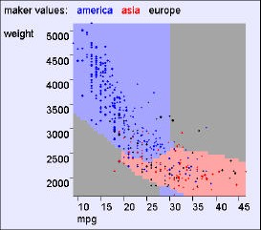
An “MPG” example
Copyright © 2001, Andrew W. Moore
Gaussian Bayes Classifiers: Slide 29
An “MPG” example
Things to note: Class Boundaries can be weird shapes (hyperconic sections) Class regions can be non-simply- connected But it’s impossible to model arbitrarily weirdly shaped regions Test your understanding: With one input, must classes be simply connected?
Copyright © 2001, Andrew W. Moore Gaussian Bayes Classifiers: Slide 30

Slide 16
Overfitting dangers
Problem with “Joint” Bayes classifier:
#parameters exponential with #dimensions.
This means we just memorize the training data, and can overfit.
Copyright © 2001, Andrew W. Moore
Gaussian Bayes Classifiers: Slide 31
Overfitting dangers
Problem with “Joint” Bayes classifier:
#parameters exponential with #dimensions.
This means we just memorize the training data, and can overfit.
Problemette with Gaussian Bayes classifier:
#parameters quadratic with #dimensions.
With 10,000 dimensions and only 1,000 datapoints we could overfit.
Question: Any suggested solutions?
Copyright © 2001, Andrew W. Moore Gaussian Bayes Classifiers: Slide 32

Slide 17
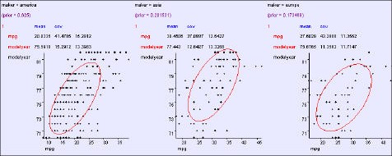
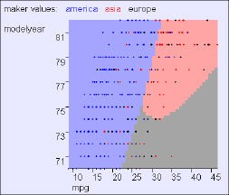
General: O(m²)
parameters
⎛⎜ ο ²1 ο … ο
⎜ ο ο ²2 … ο ⎟
   
1m
12
1m
⎞⎟
S = ⎜
12
2m
⎟
⎜
⎟
⎜_{ο}
ο … ο
2
⎟
⎝
2 m
m
⎠
Copyright © 2001, Andrew W. Moore
Gaussian Bayes Classifiers: Slide 33
General: O(m²)
parameters
⎛⎜ ο ²1 ο … ο
⎜ ο ο ²2 … ο ⎟
   
1m
12
1m
⎞⎟
S = ⎜
12
2m
⎟
⎜
⎟
⎜_{ο}
ο …
2 ⎟
⎝
2 m
ο m
⎠
Copyright © 2001, Andrew W. Moore
Gaussian Bayes Classifiers: Slide 34

Slide 18
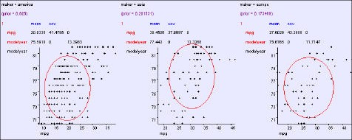
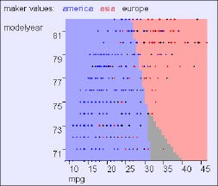
Aligned: O(m)
parameters
⎛⎜ ο ²1 0 0 … 0 0 ⎞⎟
⎜ 0 ο ²2 0 … 0 0 ⎟
⎜ 0 0 ο ²3 … 0
⎜       ⎟
0 0 … ο ² m−1
0 0 … 0
₀ ⎟
S = ⎜
⎟
⎜ ₀
₀ ⎟
⎜
⎟
⎜ ₀
2 ⎟
⎝
ο m
⎠
Copyright © 2001, Andrew W. Moore
Gaussian Bayes Classifiers: Slide 35
Aligned: O(m)
parameters
⎛⎜ ο ²1 0 0 … 0 0 ⎞⎟
⎜ 0 ο ²2 0 … 0 0 ⎟
⎜ 0 0 ο ²3 … 0
⎜       ⎟
0 0 … ο ² m−1
0 0 … 0
₀ ⎟
S = ⎜
⎟
⎜ ₀
₀ ⎟
⎜
⎟
⎜ ₀
2
⎟
⎝
ο m
⎠
Copyright © 2001, Andrew W. Moore
Gaussian Bayes Classifiers: Slide 36

Slide 19
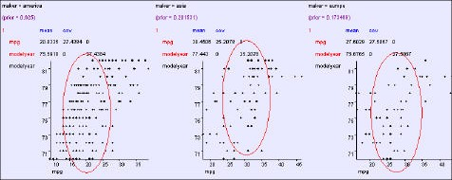
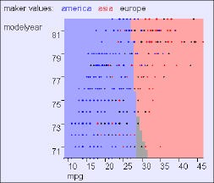
Spherical: O(1)
cov parameters
⎛ο ² 0 0 … 0 0 ⎞
ο ² 0 … 0
0 ο ² … 0
⎜       ⎟
0 0 … ο ²
⎜ 0 0 0 … 0
⎜
⎜ 0
⎜ ₀
⎟
0 ⎟
₀ ⎟
S = ⎜
⎟
⎜ ₀
₀ ⎟
⎜
⎟
⎝
ο
2
⎟
⎠
Copyright © 2001, Andrew W. Moore
Gaussian Bayes Classifiers: Slide 37
Spherical: O(1)
cov parameters
⎛ο ² 0 0 … 0 0 ⎞
ο ² 0 … 0
0 ο ² … 0
⎜       ⎟
0 0 … ο ²
⎜ 0 0 0 … 0
⎜
⎜ 0
⎜ ₀
⎟
0 ⎟
₀ ⎟
S = ⎜
⎟
⎜ ₀
₀ ⎟
⎜
⎟
⎝
ο
2 ⎟
⎠
Copyright © 2001, Andrew W. Moore
Gaussian Bayes Classifiers: Slide 38

Slide 20
BCs that have both real and categorical inputs?
Categorical inputs only
Real-valued inputs only
Mixed Real / Cat okay
Inputs Inputs Inputs
Classifier
Predict category
Joint BC
Naïve BC
Gauss BC
Dec Tree BC Here???
 | Density Estimator
Prob- ability
Joint DE Naïve DE
Gauss DE
Regressor
Predict real no.
Copyright © 2001, Andrew W. Moore
Gaussian Bayes Classifiers: Slide 39
BCs that have both real and categorical inputs?
Categorical inputs only
Real-valued inputs only
Mixed Real / Cat okay
Inputs Inputs Inputs
Classifier
Predict
Joint BC Naïve BC
Gauss BC
Dec Tree BC Here???
category
Joint DE Naïve DE
Gauss DE
 | Density Estimator
Prob- ability
Regressor
Predict real no.
Easy!
Guess how?
Copyright © 2001, Andrew W. Moore
Gaussian Bayes Classifiers: Slide 40

Slide 21


BCs that have both real and categorical inputs?
Categorical inputs only
Real-valued inputs only
Mixed Real / Cat okay
Inputs Inputs Inputs
Classifier
Predict category
Joint BC
Naïve BC
Gauss BC
Dec Tree Gauss/Joint BC Gauss Naïve BC
 | Density Estimator
Prob- ability
Joint DE Naïve DE
Gauss DE Gauss DE
Gauss/Joint DE Gauss Naïve DE
Regressor
Predict real no.
Copyright © 2001, Andrew W. Moore
Gaussian Bayes Classifiers: Slide 41
BCs that have both real and categorical inputs?
Categorical inputs only
Real-valued inputs only
Mixed Real / Cat okay
Inputs Inputs Inputs
Classifier
Predict
Joint BC Naïve BC
Gauss BC
Dec Tree Gauss/Joint BC Gauss Naïve BC
category
Joint DE Naïve DE
Gauss DE Gauss DE
 | Density Estimator
Prob- ability
Gauss/Joint DE Gauss Naïve DE
Regressor
Predict real no.
Copyright © 2001, Andrew W. Moore
Gaussian Bayes Classifiers: Slide 42

Slide 22
Mixed Categorical / Real Density Estimation
Write x = (u,v) = (u₁ ,u₂ ,…u_{q} ,v₁ ,v₂ … v_{m-q})
Real valued
Categorical valued
P(x |M)= P(u,v |M)
(where M is any Density Estimation Model)
Copyright © 2001, Andrew W. Moore
Gaussian Bayes Classifiers: Slide 43
Joint / Gauss DE Combo
P(u,v |M) = P(u |v ,M) P(v |M)
Not sure which tasty
DE to enjoy? Try our…
Gaussian with parameters depending on v
Big “m-q”- dimensional lookup table
Copyright © 2001, Andrew W. Moore
Gaussian Bayes Classifiers: Slide 44

Slide 23
MLE learning of the Joint / Gauss DE Combo
P(u,v |M) = P(u |v ,M) P(v |M)
μ_{v}
= Mean of u among records matching v
Σ_{v}
= Cov. of u among records matching v
q_{v}
= Fraction of records that match v
u |v ,M ~ N(μ_{v} , Σ_{v}) , P(v |M) = q_{v}
Copyright © 2001, Andrew W. Moore Gaussian Bayes Classifiers: Slide 45
MLE learning of the Joint / Gauss DE Combo
P(u,v |M) = P(u |v ,M) P(v |M)
μ_{v}
= Mean of u among records matching v
=
1
∑ u
R
1
k
Σ_{v}
= Cov. of u among records matching v
=
v k s.t. v _{k} = v
∑ k v k v
R
(u − µ )(u − µ )^{T}
q_{v}
= Fraction of records that match v
= R_{v} R
v k s.t.v _{k} = v
R_{v} = # records that match v
u |v ,M ~ N(μ_{v} , Σ_{v}) , P(v |M) = q_{v}
Copyright © 2001, Andrew W. Moore Gaussian Bayes Classifiers: Slide 46

Slide 24
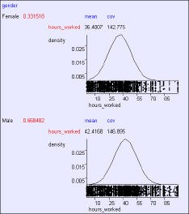
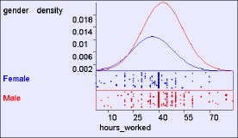
Gender and Hours Worked*
*As with all the results from the UCI “adult census” dataset, we can’t draw any real-world conclusions since it’s such a non-real-world sample
Copyright © 2001, Andrew W. Moore Gaussian Bayes Classifiers: Slide 47
What we just did
Joint / Gauss DE Combo
Copyright © 2001, Andrew W. Moore
Gaussian Bayes Classifiers: Slide 48

Slide 25
What we do next
Joint / Gauss BC
Combo
Copyright © 2001, Andrew W. Moore
Gaussian Bayes Classifiers: Slide 49
Joint / Gauss BC
Combo
_{P(Y = i | u, v ) =} p(u, v | M _{i} )P(Y = i)
p(u, v)
₌ p (u,| v, M _{i} ) p(v | M_{i} )P(Y = i)
p (u, v )
₌ N (u;µ_{i, v} , S _{i, v} ) q_{i, v} p_{i}
p(u, v)
Copyright © 2001, Andrew W. Moore
Gaussian Bayes Classifiers: Slide 50

Slide 26
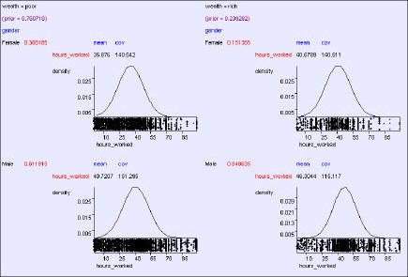
P(Y | = |  | Joint / Gauss BC Combo _{i | u, v ) =} p(u, v | M _{i} )P(Y = i) p(u, v)
μ_{i,v} = Mean of u among records matching v and in which y=i |  | ₌ p (u,| v, M _{i} ) p(v | M_{i} )P(Y = i) p (u, v ) ₌ N (u;µ_{i, v} , S _{i, v} ) q_{i, v} p_{i} p(u, v) Rather so-so-notation for “Gaussian with mean μ_{i,v} and covariance Σ _{i,v} evaluated at u”
Σ_{i,v} = Cov. of u among records matching v and in which y=i
q_{i,v} = Fraction of “y=i” records that match v
p_{i} = Fraction of records that match “y=i”
Copyright © 2001, Andrew W. Moore |  |  | Gaussian Bayes Classifiers: Slide 51
Gender, Hours→Wealth
Copyright © 2001, Andrew W. Moore
Gaussian Bayes Classifiers: Slide 52

Slide 27
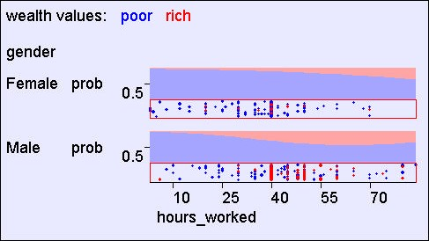
Gender, Hours→Wealth
Copyright © 2001, Andrew W. Moore
Gaussian Bayes Classifiers: Slide 53
Joint / Gauss DE Combo and Joint / Gauss BC Combo: The downside
(Yawn…we’ve done this before…)
More than a few categorical attributes blah blah blah massive table blah blah lots of parameters blah blah just memorize training data blah blah blah do worse on future data blah blah need to be more conservative blah
Copyright © 2001, Andrew W. Moore
Gaussian Bayes Classifiers: Slide 54

Slide 28


Naïve/Gauss combo for Density
Real
Categorical
Estimation
⎛
q
⎞⎛ m − q
⎞
p(u, v | M ) = ⎜∏ p(u _{j} | M ) ⎟⎜∏ P(v _{j} | M ) ⎟
⎝ j=1
⎠⎝ j =1
⎠
u | M ~ N (μ ,ο ² )
j j j
v _{j} | M ~ Multinomial[q _{j1}, q _{j 2} ,..., q _{jN} ]
j
How many parameters?
Copyright © 2001, Andrew W. Moore
Gaussian Bayes Classifiers: Slide 55
Naïve/Gauss combo for Density
Real
Categorical
Estimation
⎛
q
⎞⎛ m − q
⎞
p(u, v | M ) = ⎜∏ p(u _{j} | M ) ⎟⎜∏ P(v _{j} | M ) ⎟
⎝ j=1
⎠⎝ j =1
⎠
u | M ~ N (μ ,ο ² )
j j j
v _{j} | M ~ Multinomial[q _{j1}, q _{j 2} ,..., q _{jN} ]
₌ 1
R
j
μ
∑ kj
j
u
k
ο
2
j
=
1
R
∑
(u_{kj} − μ _{j} )
2
k
q
₌ # of records in which v _{j} = h
jh
R
Copyright © 2001, Andrew W. Moore
Gaussian Bayes Classifiers: Slide 56

Slide 29
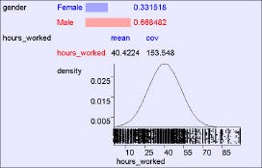
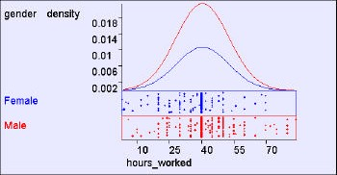
Naïve/Gauss DE Example
Copyright © 2001, Andrew W. Moore
Gaussian Bayes Classifiers: Slide 57
Naïve/Gauss DE Example
Copyright © 2001, Andrew W. Moore
Gaussian Bayes Classifiers: Slide 58

Slide 30
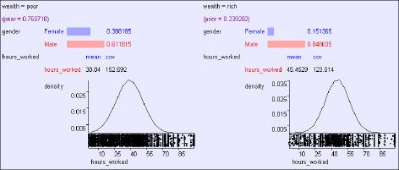
^{Naïve /} p(u, v | Y = i)P(Y = i) Gauss BC ^{P(Y = i | u, v ) =} p(u, v) q m− q = ^{1} ∏ p (u | μ , ο ² ) P(v | q ) P(Y = i) _{p (u, v)} j ij ij ∏ j ij j =1 j=1 q m− q = ¹ ∏ N (u ; μ ,ο ² ) q [v ] p _{p (u, v)} j ij ij ∏ ij j i j =1 j=1
 | μ_{ij} = Mean of u_{j} among records in which y=i
 | ο² = Var. of u_{j} among records in which y=i ij
 | q_{ij}[h] = Fraction of “y=i” records in which v_{j} = h
 | p_{i} = Fraction of records that match “y=i”
Copyright © 2001, Andrew W. Moore Gaussian Bayes Classifiers: Slide 59
Gauss / Naïve BC Example
Copyright © 2001, Andrew W. Moore
Gaussian Bayes Classifiers: Slide 60

Slide 31
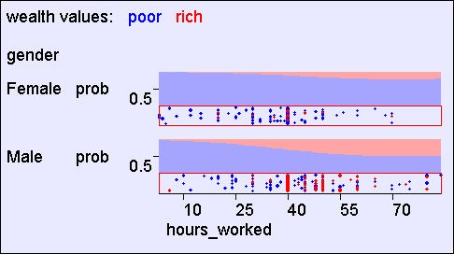
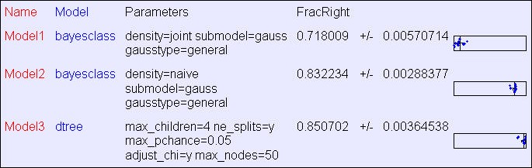
Gauss / Naïve BC Example
Copyright © 2001, Andrew W. Moore
Gaussian Bayes Classifiers: Slide 61
Learn Wealth from 15 attributes
Copyright © 2001, Andrew W. Moore
Gaussian Bayes Classifiers: Slide 62

Slide 32
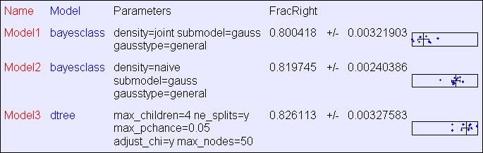
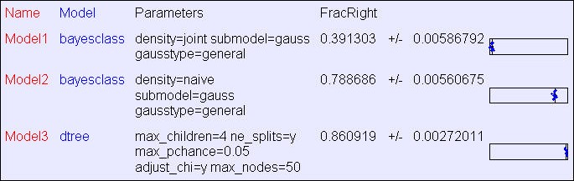
Learn Wealth from 15 attributes
Same data, except all real values discretized to 3 levels
Copyright © 2001, Andrew W. Moore Gaussian Bayes Classifiers: Slide 63
Learn Race from 15 attributes
Copyright © 2001, Andrew W. Moore
Gaussian Bayes Classifiers: Slide 64

Slide 33
What you should know
A lot of this should have just been a corollary of what you already knew
Turning Gaussian DEs into Gaussian BCs
Mixing Categorical and Real-Valued
Copyright © 2001, Andrew W. Moore
Gaussian Bayes Classifiers: Slide 65
Questions to Ponder
Suppose you wanted to create an example dataset where a BC involving Gaussians crushed decision trees like a bug. What would you do?
Could you combine Decision Trees and Bayes Classifiers? How? (maybe there is more than one possible way)
Copyright © 2001, Andrew W. Moore
Gaussian Bayes Classifiers: Slide 66

